Slide 1
Practice 6

Slide 2
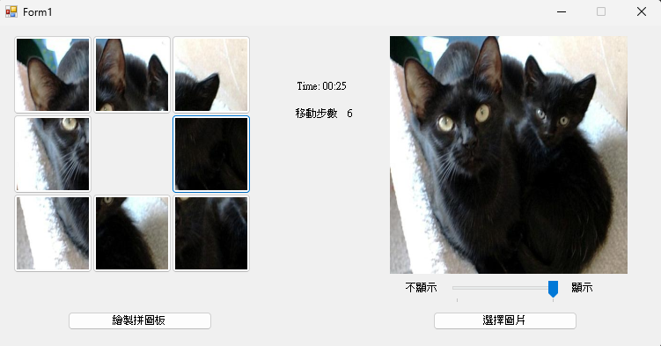
Practice 6-1 Puzzle Game
movement steps
Do not show
show
Draw puzzle board
select an image

Slide 3
Game Procedure
Select an image
Create a puzzle board
Start game
Move puzzle board
Calculate game time and movement steps
Game over
Show game time and movement steps
Lock the puzzle

Slide 4
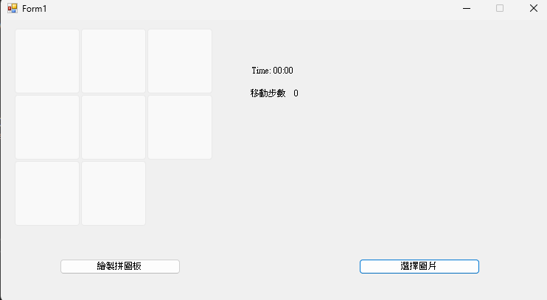
Game Start Screen
Instructions:
Please create a 3x3 grid of blank areas and hide one of the blocks within it.

Slide 5
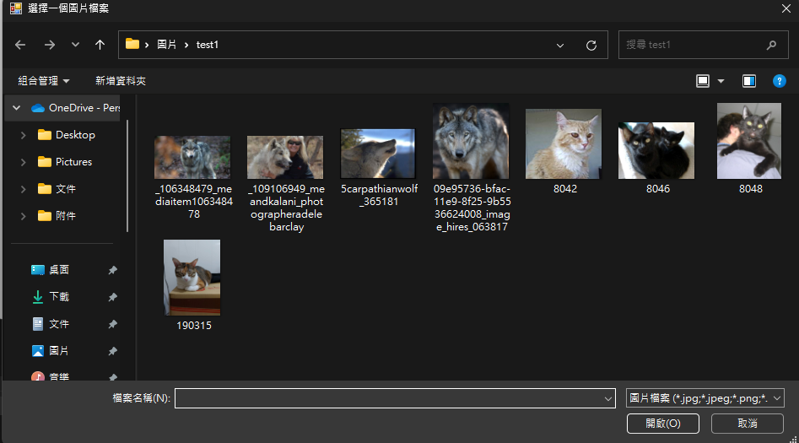
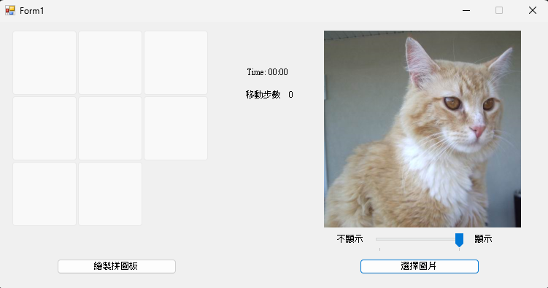
1. Select an Image
Instructions:
The player selects an image, and the image is shown on the right. Please resize the image to a fixed size and do not let the photo exceed the range.

Slide 6
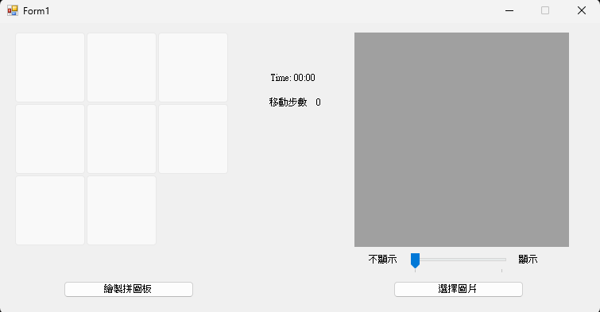
1. Select an Image
Instructions:
Must provide the functionality to display and hide images.

Slide 7
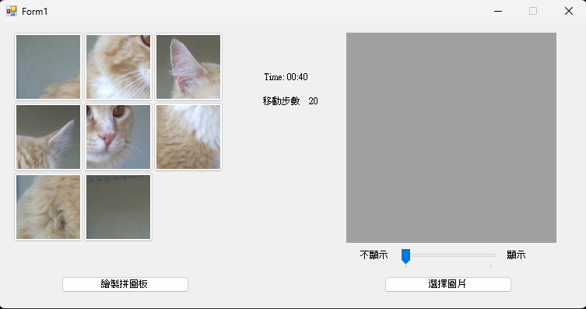
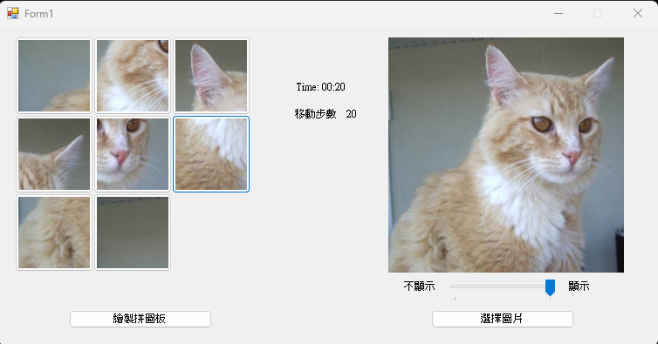
2. Create a Puzzle Board
Instructions:
After clicking the “Draw puzzle board”, divide the image into 9 blocks, hide one of them, and then randomly place the others on the puzzle board.

Slide 8
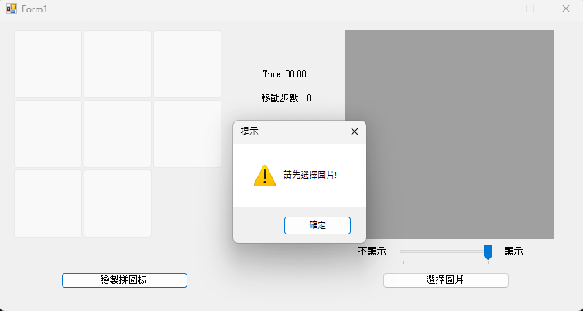
2. Create a Puzzle Board
Instructions:
If no image was placed, output a warning: Please select an image first

Slide 9
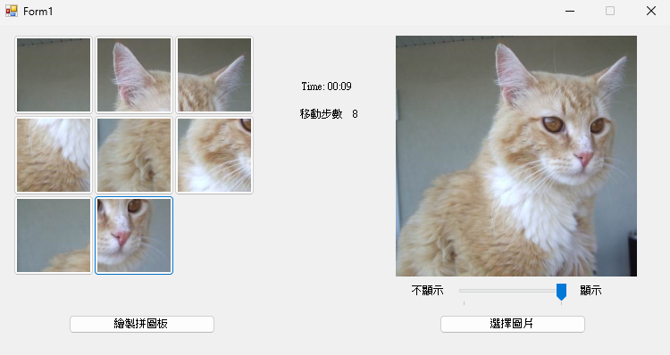
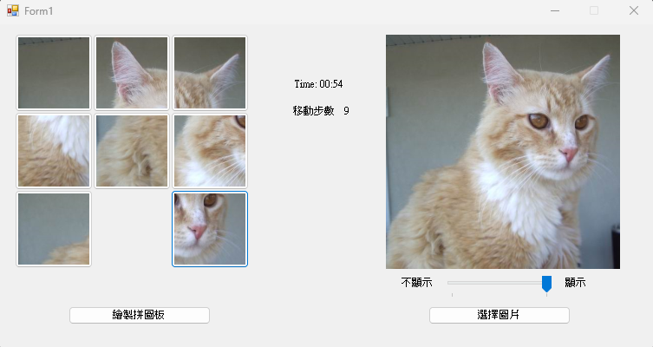
3. Start Game (Move Puzzle Board)
Instructions:
Clicking on a certain block, move that block to the empty area.

Slide 10
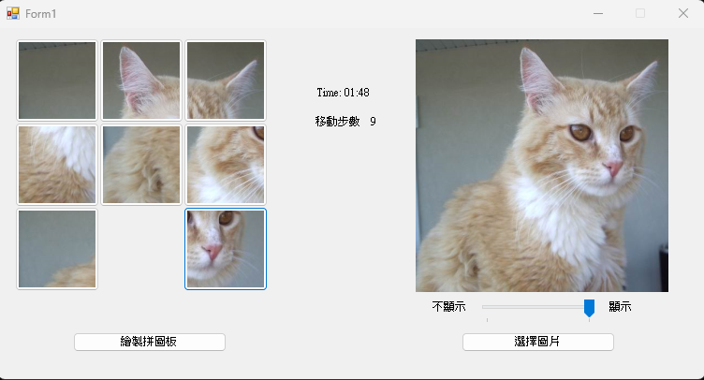
3. Start Game (Calculate Game Time and Movement Steps)
Instructions:
Calculate the elapsed time in the game (since the draw button is clicked) and the movement steps (the number of times a puzzle is moved) and show it on the game screen.

Slide 11
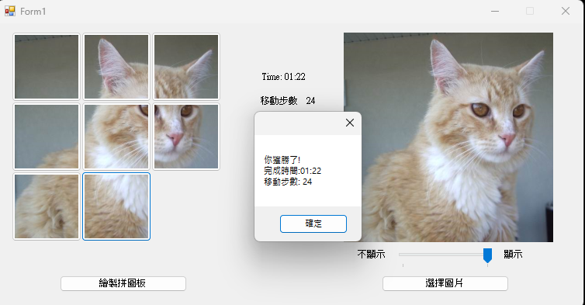
4. Game Over (Show Game Time and Movement Steps)
Instructions:
If the player reassembles the puzzle successfully, the game ends and shows game time and movement steps.
You won! Time of completion Movement steps

Slide 12
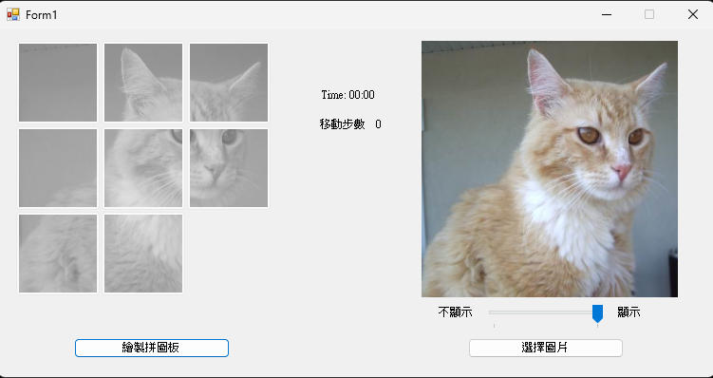
4. Game Over (Lock the Puzzle)
Instructions:
After the game is over, prevent the player from moving the puzzle board until they press “Draw puzzle board” to start a new round of the game.

Slide 13
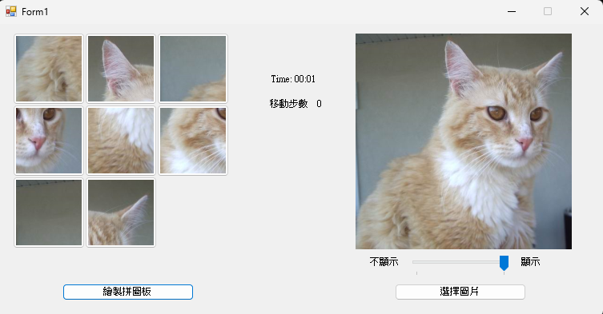
Supplementary
Instructions:
If “Draw puzzle board” was clicked during the game, refresh the entire area and resest game time and movement steps.

Slide 14
Grading
Able to read images properly (5%)
Showing and hiding images (5%)
Dividing the image into 9 blocks (20%)
Showing time and steps (10%)
Able to move the puzzle board (30%)
Calculations and locking the board at the end of the game (10%)
Able to change the image for a new round of the game (10%)
Others (10%)

Slide 15
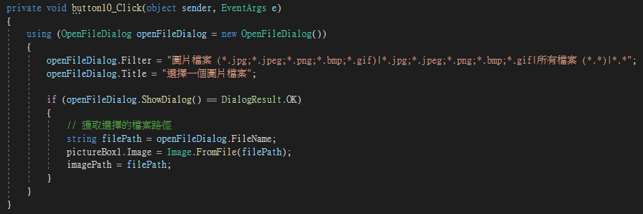
Hint
It is suggested to use Bitmap to divide the image
The suggested image resize is 270x270
Record the sequence number of each area
Whether to show or not has nothing to do with drawing the puzzle board

Slide 16
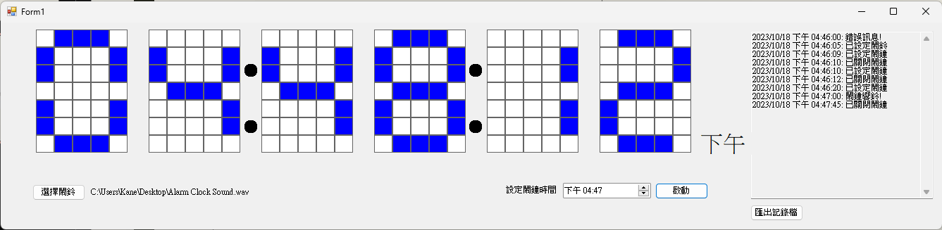
Practice 6-2 Digital Clock
Create the functionalities:
Electronic display board
Alarm setting
Customize alarm ringtone
Log record

Slide 17
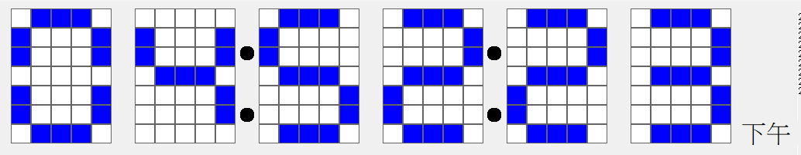
1. Electronic Display Board
Instructions:
Display the current time on the electronic display board according to Taiwan’s time (GMT+8). From left to right, indicating hour, minute, second (e.g., 11:50:12). Use the twelve-hour clock format for the hour and display "AM" or "PM" in the bottom right corner of the display board.

Slide 18
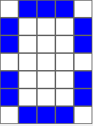
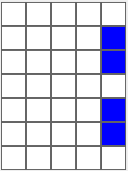
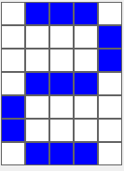
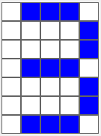
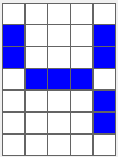
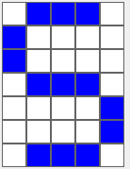
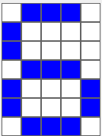
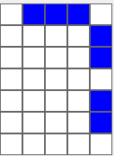
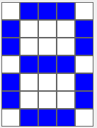
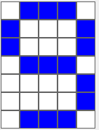
1. Electronic Display Board
Instructions:
Each display is represented using a grid of 7 units in length and 5 units in width. The display of numbers must adhere to the following format. Hint: System.Drawing.Color.Blue

Slide 19


2. Alarm setting
Instructions:
The user can set the alarm, and it goes off accordingly. The time setting only allows: morning, afternoon, hour, and minute. Also, record the messages for setting and turning off the alarm in the log. Switch the button state after done setting.
activate
alarm clock set
alarm clock turned off
stop

Slide 20

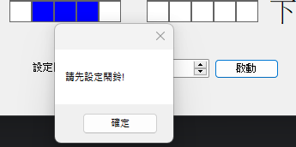


3. Customize Alarm Ringtone
Instructions:
The user can set their own alarm ringtone, and it goes off when the time is reached. If no alarm file was selected in setting, an error message will pop up: Please set the alarm first. Then, record this error message to the log.
no file selected
select alarm rington
Please set the alarm clock first
confirm
error message

Slide 21
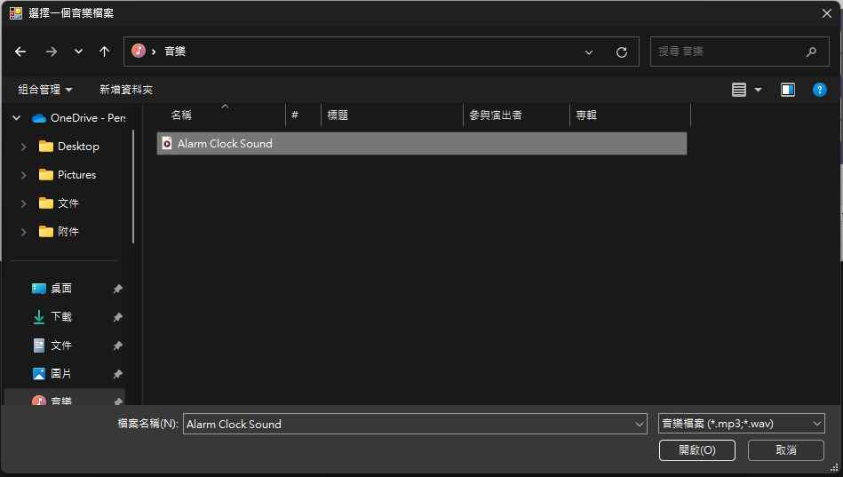
3. Customize Alarm Ringtone
Instructions:
When selecting the alarm ringtone, the user can open the interface to choose a file. Restrict the file to only those with the extensions .mp3 or .wav. Hint: openFileDialog.

Slide 22
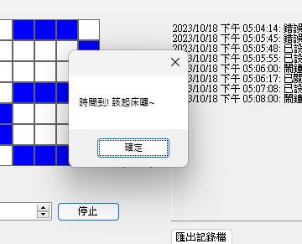
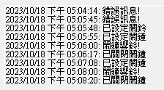
3. Customize Alarm Ringtone
Instructions:
When the alarm time is reached, output the reminder and play the alarm ringtone until the stop button is clicked.
Time’s up! Get up~
confirm
log file exported

Slide 23
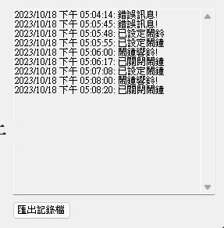
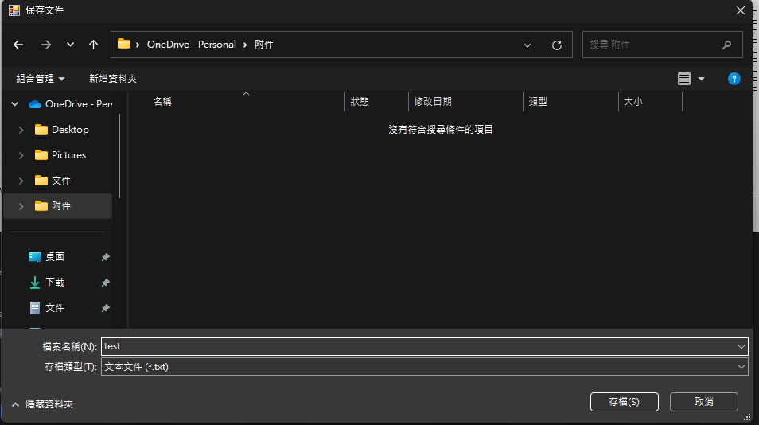
4. Log Record
Instructions:
The log will be shown next to the electronic display board, recording the time of user actions and the actions, and providing a function to export the log. Allow the user to select a path through the interface and export the log as a .txt file (must be a .txt file.) Hint: saveFileDialog.Filter

Slide 24
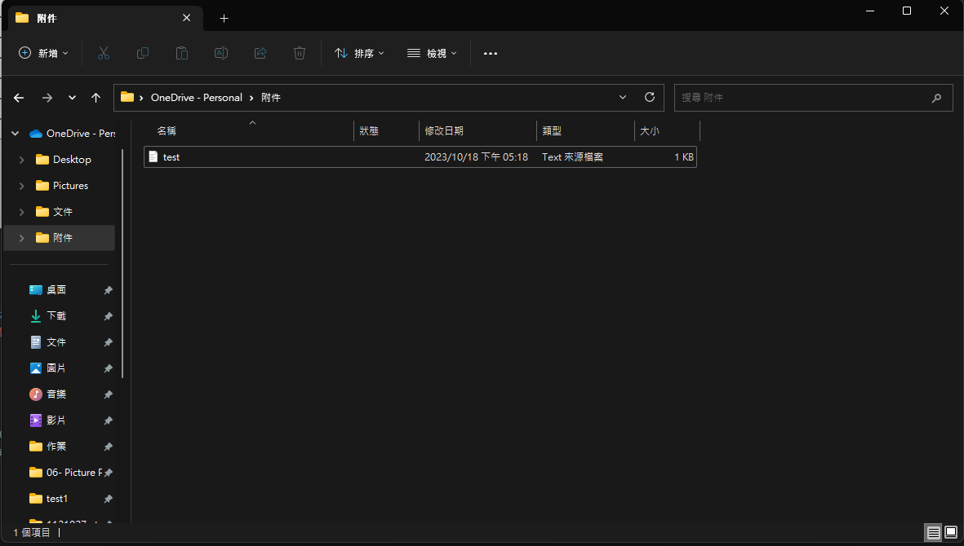
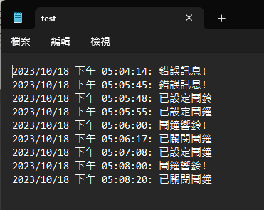
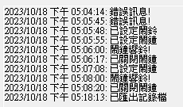
4. Log Record
Instructions:
After exporting, the file should be visible at the designated path. The content must record all information from the log, and the action must also be logged after completion.

Slide 25
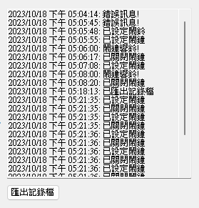
4. Log Record
Instructions:
The log must provide a scroll bar function, allowing users to view all recorded information, and users cannot directly input information into the log.

Slide 26
4. Log Record
Instructions:
The format record should be: 20XX/XX/XX afternoon XX:XX:XX: {message}
Ex. 2023/10/18 afternoon 05:05:48: alarm clock set There are five types of message records:
Error message!
Alarm ringtone set
Alarm clock set
Alarm clock turned off
Log file exported

Slide 27
Grading
Electronic display board (30%)
Alarm setting (10%)
Alarm ringtone setting (10%)
Proper functioning of the alarm (20%)
Message logging (15%)
Log export (5%)
Others (10%)

Slide 28
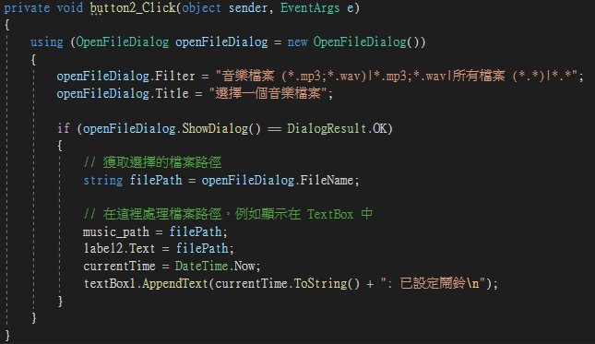
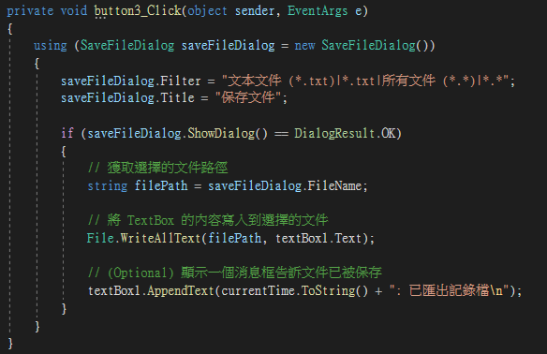
Hint
It is suggested to use pictureBox to create the display board.
SaveFileDialog, OpenFileDialog
Leverage Datetime to capture time-related information

